Slide 1
Topic Analysis on Stock Market Prediction
Satoshi Taniguchi
Kavuri Lakshmi Kausalya
Junjun Tao
DAAN 888 - Analytics Design Implementation (Fall, 2022)
Dr. Satish Mahadevan Srinivasan

Slide 2










Research/Business Goals
The Dow Jones Industrial Average (DJIA), Dow Jones is a stock market index of 30 prominent companies listed on stock exchanges in the United States.
Our goal: To predict future DJIA values from time series models and daily news sentiment.
Notes:
From the picture we could see that lymph nodes are close to breast organ.

Slide 3


Research/Business Questions
1. Which sentiment in the Daily News affects the DJIA value?
2. How will the value of future DJIA value change?
3. Do the results of the Daily News topic analysis
improve the predictive accuracy of the DJIA value?
Notes:
From the picture we could see that lymph nodes are close to breast organ.

Slide 4
Data Collection
Economic News Data
Objective: Complete sentimental analysis based on daily news.
Source: Historical news headlines from Reddit Economy Channel (/r/Economy).
Method: Using Pushshift API, which is designed to download data from Reddit.
News: Top 50 headlines sorted by the number of comments for a single date.
Range: 2017-06-08 to 2022-08-31
DJIA Value Data
Objective: Complete the DJIA value predictions
Source: Historical data from The Wall Street Journal.
Method: Downloaded from the web site as a csv file.
Range: 2017-06-08 to 2022-08-31
Notes:
From the picture we could see that lymph nodes are close to breast organ.

Slide 5
Data Collection
Economic News Data
Objective: Complete sentimental analysis based on daily news.
Source: Historical news headlines from Reddit Economy Channel (/r/Economy).
Method: Using Pushshift API, which is designed to download data from Reddit.
News: Top 50 headlines sorted by the number of comments for a single date.
Range: 2017-06-08 to 2022-08-31
DJIA Value Data
Objective: Complete the DJIA value predictions
Source: Historical data from The Wall Street Journal.
Method: Downloaded from the web site as a csv file.
Range: 2017-06-08 to 2022-08-31
Notes:
From the picture we could see that lymph nodes are close to breast organ.

Slide 6
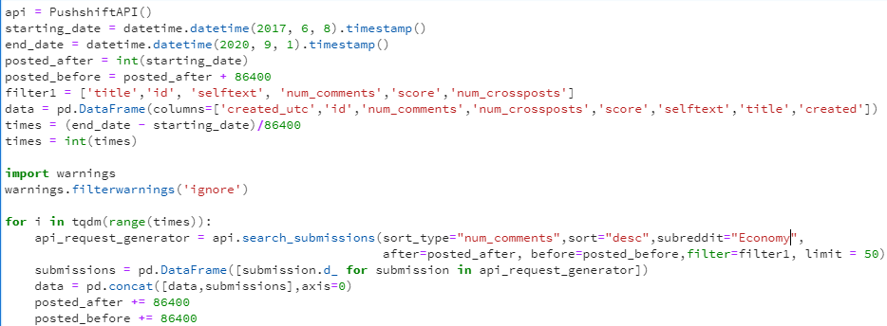
Data Collection
Attributes that we want to obtain
Subreddit
Number of posts for each day

Slide 7
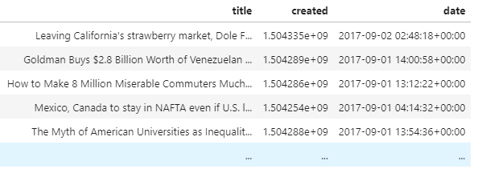
Data Description – for News Data
Brief Overview:
Descriptions:
Id: (String) The unique id number for each Reddit New
Num_comments: (Numeric) The number of comments under each Reddit New
Score: (Numeric) The score for each new evaluated by Reddit
Title: (String) The title of each Reddit New
Created: (Float) The timestamp for each new’s creation
Date: (DateTime) The post date and time for each Reddit New

Slide 8
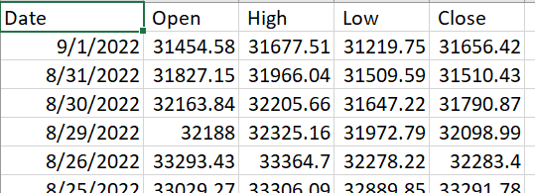
Data Description – for Stock Data
Brief Overview:
Descriptions:
Date: The date on which the stock price is being traded.
Open: The price of the stocks at the opening time of the stock market.
Close: The price of the stocks at the closing time of the stock market.
High: The highest price for the stocks traded on the day.
Low: The lowest price for the stocks traded on the day.

Slide 9

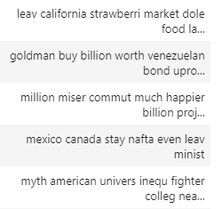
Data Cleaning result
Before
1. The News data set
Step 1: Import necessary libraries and packages
Step 2: Remove missing values by using df.dropna()
Step 3: Remove special characters
Step 4: Remove stop words
Step 5: Lemmatization and Stemming
2. The Stock price data set
We did not perform any data cleaning because there is no missing value in the data set.
After

Slide 10
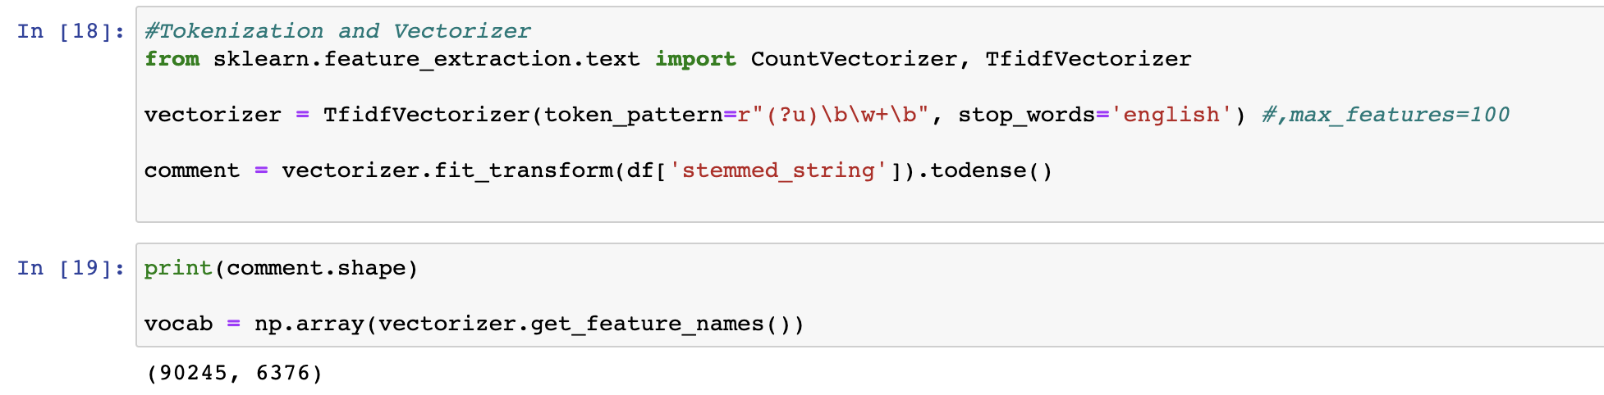
Data Transformation – News Data
Use TfidfVectorizer() in Sklearn to build vectorizer. The vectorizer tokenizes the sentences and removes the stopwords. It also transforms sentences into lower case.
The shape of vector shows that we have 90,245 total news records and 6376 unique words after removing the stopwords.

Slide 11
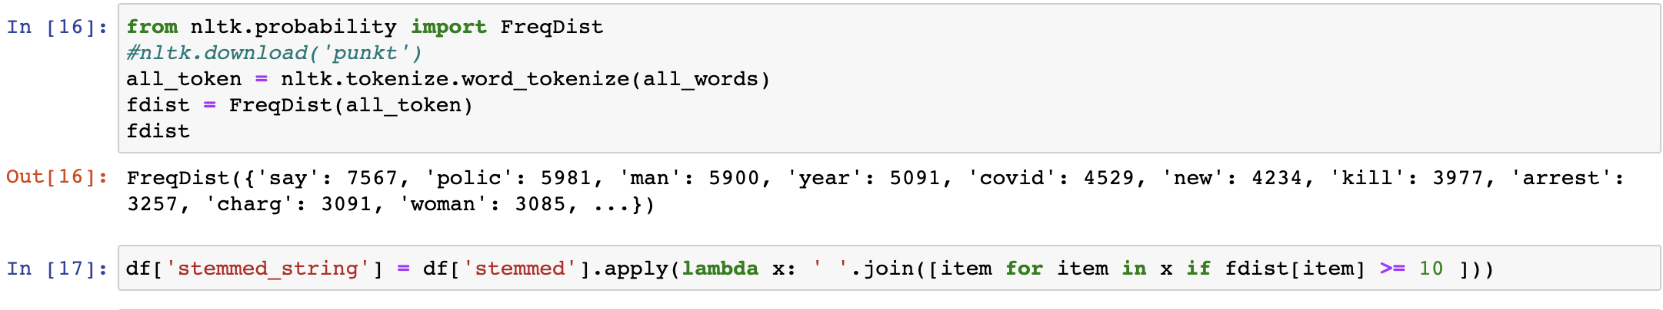
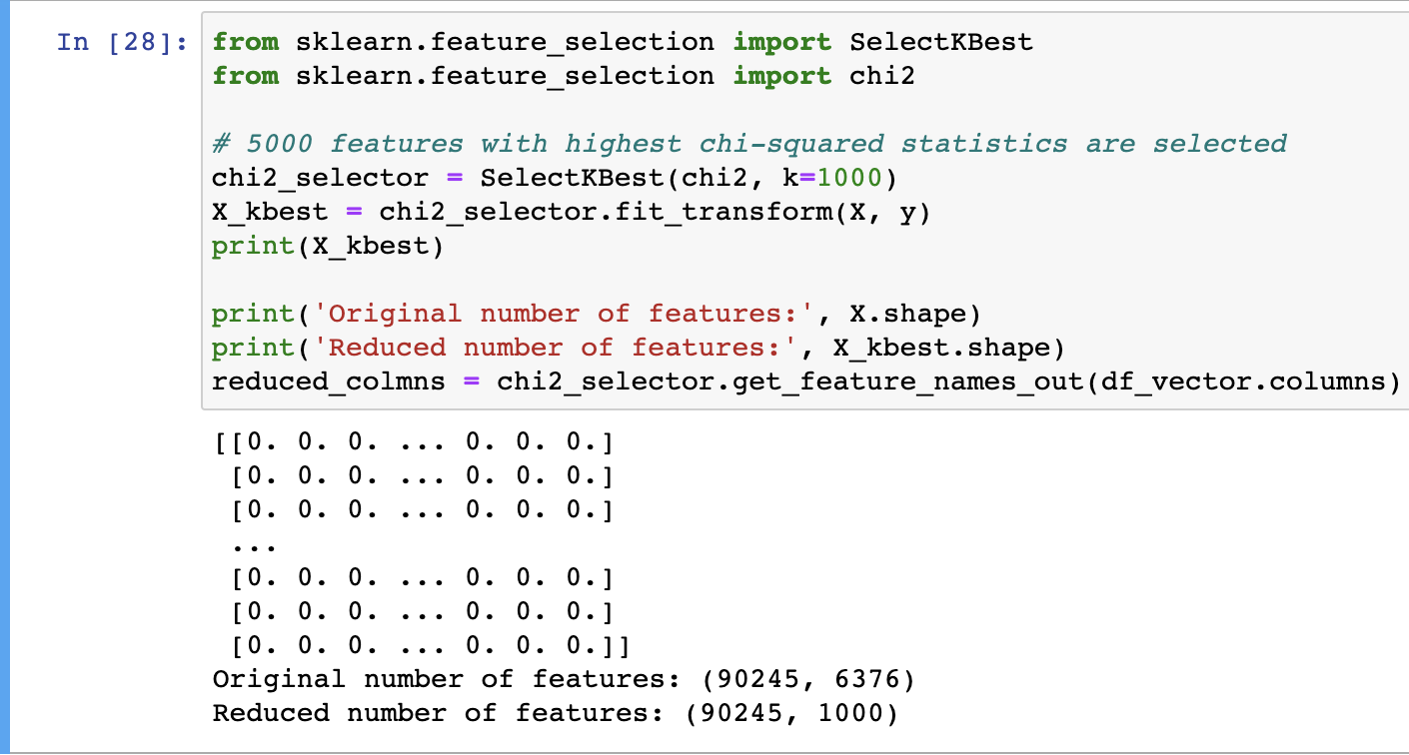
Features Reduction– News Data
Remove infrequent words. Because they’re so rare, the association between them and other words is dominated by noise. So, we kept words whose frequencies are greater than 10.
Select features based on chi-squared statistics. Since we are going to use KMeans model to perform clustering, we need to select features to reduce the data complexity. In this case, 1000 features with highest chi-squared statistics are selected.

Slide 12
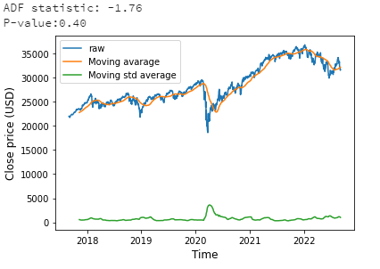
Data Transformation – Stock price
The Stock price data set
The result of the ADF test indicates that the data is non-stationary at 40%.
Step 1: Compute difference
Step 2: Confirm that the data is stationary

Slide 13
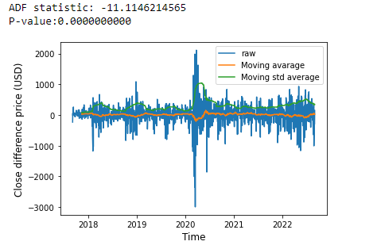
Data Transformation – Stock price
We applied differencing (d = 1) to obtain stationary data.
The result of ADF test indicates that the differenced data is stationary
because the P – value is quite small.

Slide 14
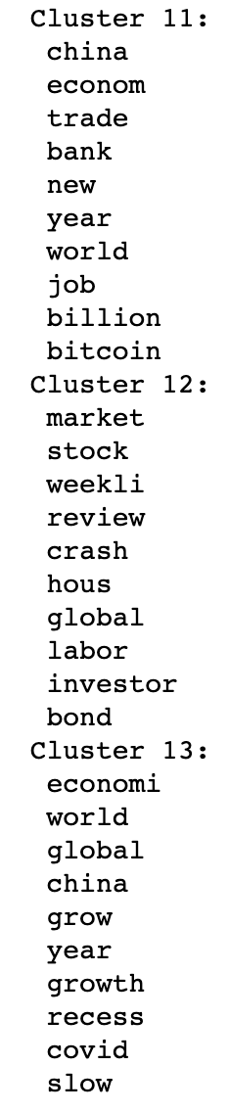
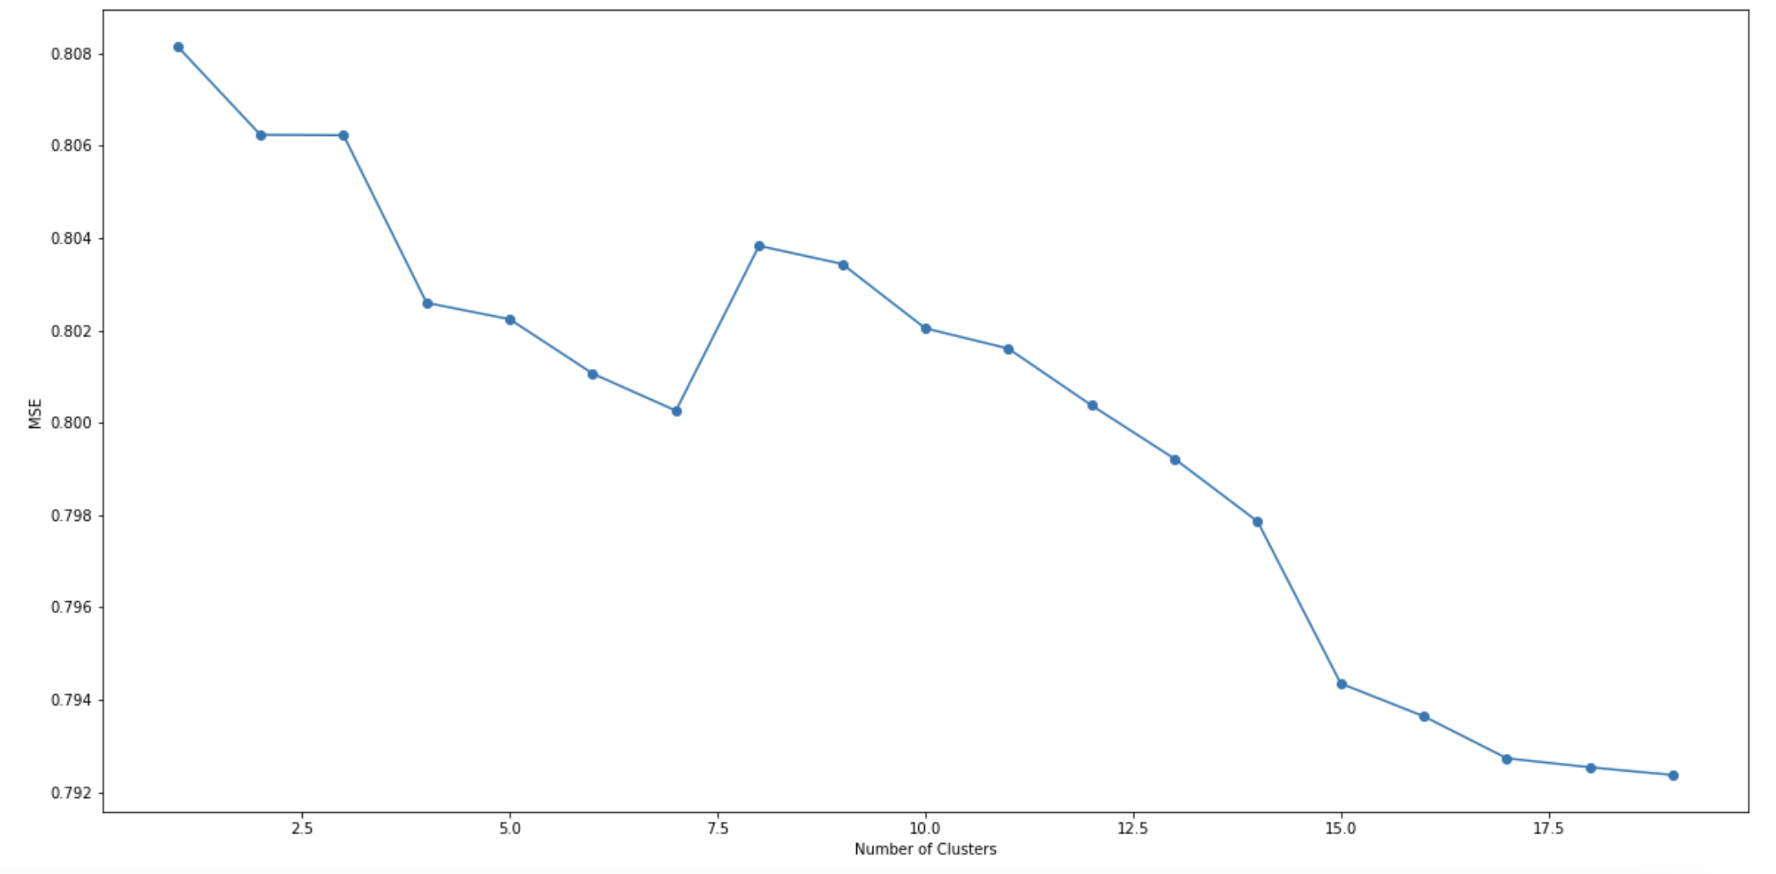
Modeling Results – News Data (Without Features Deduction)
We plot the trending line for MSE value to see model's performance with the change of number of clusters.
The top terms per cluster are exported. From the results we can have an initial understanding that there are several clusters which regard to topics such as stocks, market, economy and so on.

Slide 15
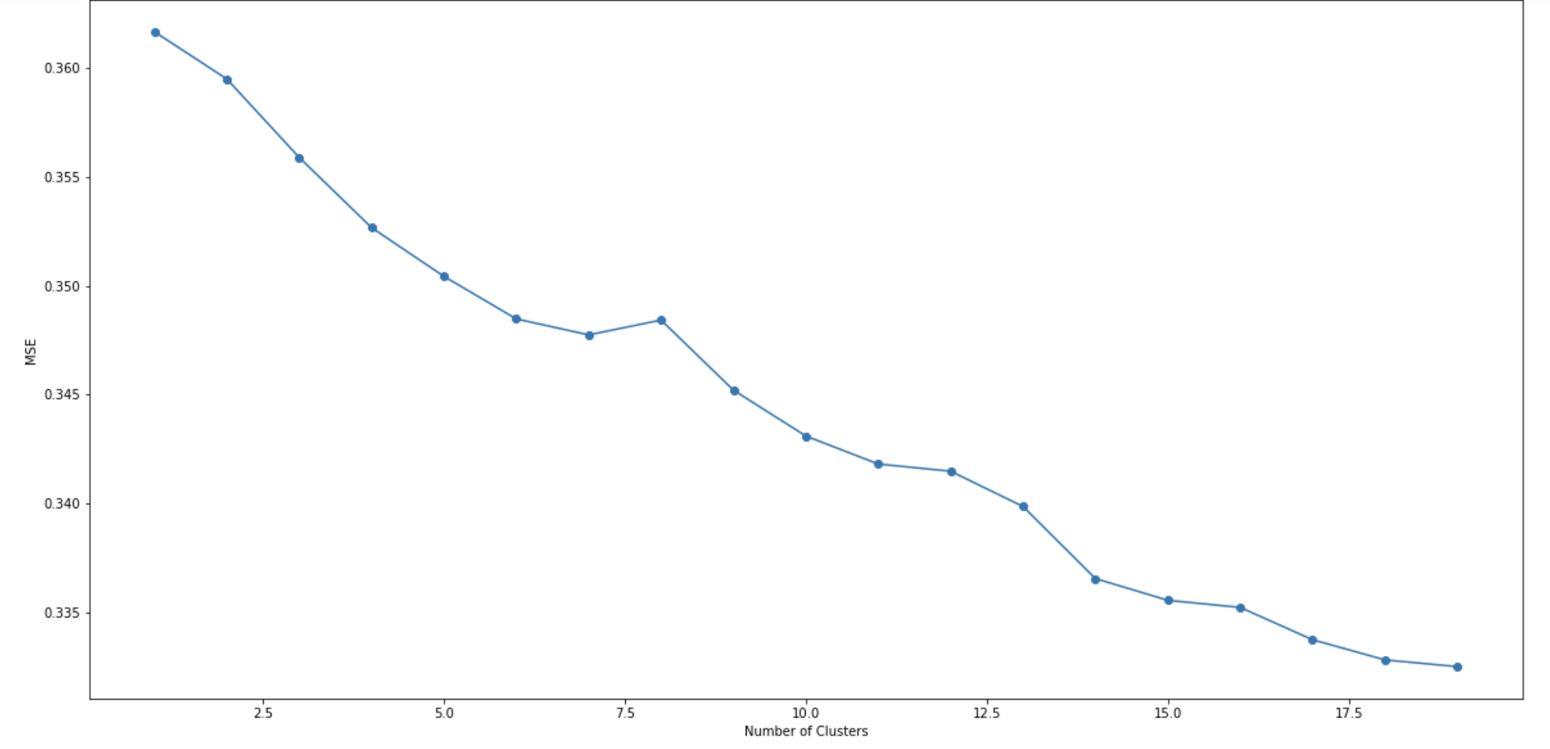
Modeling Results – News Data (With Features Deduction)
The MSE trending line shows that with the features deduction, the model's performance becomes better than before.
We choose 14 to be the final value of clusters number because the slope of MSE trending line becomes smaller after 14.

Slide 16
Modeling Results – News Data (With Features Deduction)
Example of topics (top terms per topic)
Topic 2: stock, buy, trade, best, tip, investor, invest, week, rise, exchang
The key words in this topic indicate that the topic is related to investment in stock and buy in or sale out operations.
Topic 7: price, oil, rise, high, home, year, fall, gold, hous, surg
The key words in this topic indicate that the topic is related to oil, gold and house prices' change.
Topic 11: china, econom, trade, bank, new, year, world, job, billion, bitcoin
The key words in this topic indicate that the topic is related to countries' economic and job opportunities. It also talks about cryptocurrencies such as Bitcoin.

Slide 17
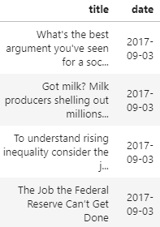
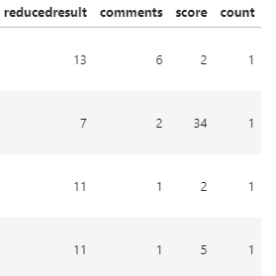
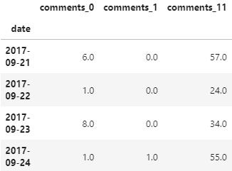
Modeling – Stock Price Prediction
Data Transformation for the result of topic modeling.
Topics
.....
.....
Aggregate the number of comments, score, and count for each day.
Apply Box-Cox Transformation, remove outliers, and Min-Max Scaler.
Notes:
SSE: Sum of squared errors can be influenced by the number of inputs. So we choose MSE

Slide 18
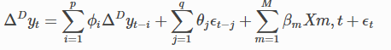
Modeling – Stock Price Prediction
ARIMA model
ARIMAX model
Null model
Randomly predicts the price based on the distribution of training dataset.
AR
MA
AR
MA
X
Notes:
SSE: Sum of squared errors can be influenced by the number of inputs. So we choose MSE

Slide 19
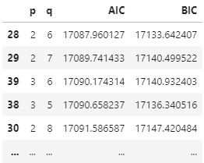
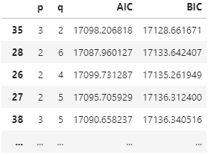
Modeling – Stock Price Prediction
Parameters
The combination of p = 2 and q = 6 is the best.
Notes:
SSE: Sum of squared errors can be influenced by the number of inputs. So we choose MSE

Slide 20
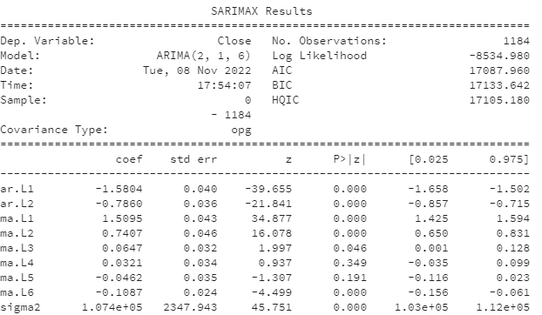
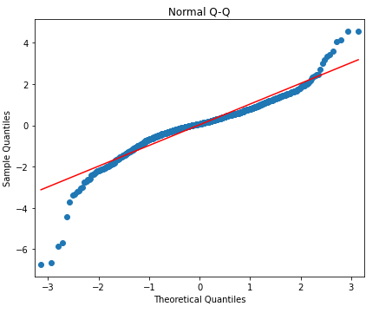
Modeling – Stock Price Prediction
Summary of ARIMA model
Notes:
SSE: Sum of squared errors can be influenced by the number of inputs. So we choose MSE

Slide 21
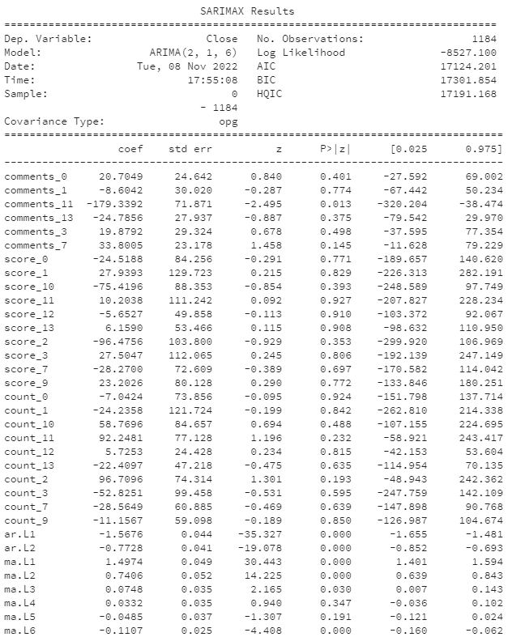
Modeling – Stock Price Prediction
Summary of ARIMAX model
Notes:
SSE: Sum of squared errors can be influenced by the number of inputs. So we choose MSE

Slide 22
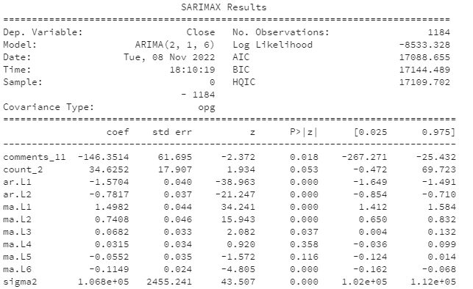
Modeling – Stock Price Prediction
Summary of ARIMAX (Top two features) model
Model | RMSE
ARIMA | 329.4
ARIMAX (All features) | 327.1
ARIMAX (Top two features) | 328.9
Notes:
SSE: Sum of squared errors can be influenced by the number of inputs. So we choose MSE

Slide 23
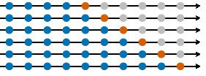
Modeling – Stock Price Prediction
Model Evaluation in the test dataset
We applied Rolling Forecast to the test data.
The prediction of our model is more accurate than Null model,
which randomly predicts based on the distribution of training dataset.
1/1
1/2
1/3
1/4
1/5
1/6
1/7
1/8
1/9
1/10
Model | RMSE
ARIMA | 378.5
ARIMAX (All features) | 367.9
ARIMAX (Top two features) | 374.0
Null Model | 534.0
Forecast
Training data
Notes:
SSE: Sum of squared errors can be influenced by the number of inputs. So we choose MSE

Slide 24
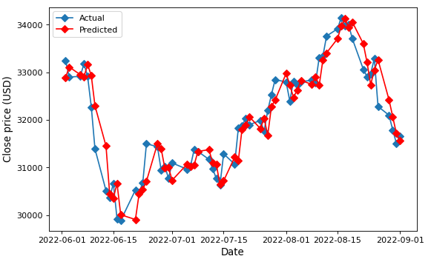
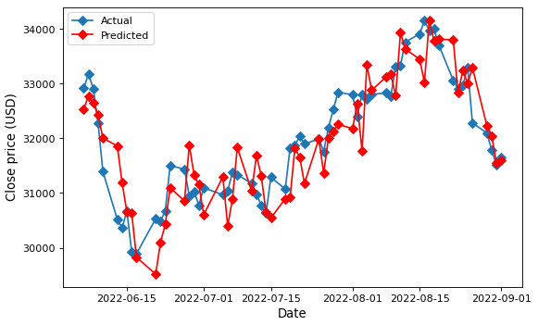
Modeling – Stock Price Prediction
Model Evaluation in the test dataset
Compared to Null model, the prediction of our model is more accurate.
ARIMAX (TOP 2 features)
Null model
Notes:
SSE: Sum of squared errors can be influenced by the number of inputs. So we choose MSE

Slide 25
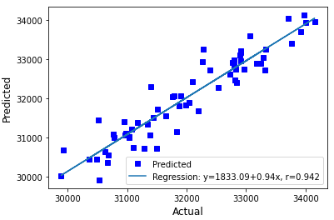
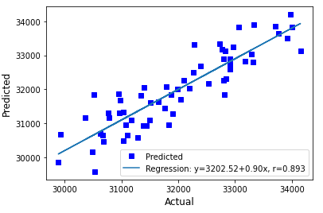
Modeling – Stock Price Prediction
Model Evaluation in the test dataset
ARIMAX (TOP 2 features)
Null model
Notes:
SSE: Sum of squared errors can be influenced by the number of inputs. So we choose MSE

Slide 26
Discussion and Conclusion
Our ARIMA and ARIMAX models have significantly higher prediction accuracy compared to the Null model.
This fact indicates that there is a time-series dependence in stock price.
There is no distinct difference in the accuracy of the ARIMA and ARIMAX models.
This fact means that external variables based on our topic modeling results had no effect on improving the accuracy of the forecast.
However, we cannot conclude that economic news trends do not affect stock prices in our project.
Notes:
SSE: Sum of squared errors can be influenced by the number of inputs. So we choose MSE

Slide 27
Future works
Our Topic modeling results are unstable, since changing the number of clusters to be classified or the random seed can significantly change the clusters obtained.
Adopting supervised learning, using pre-prepared might improve the accuracy of stock price prediction.
the current model considers news trends from one day prior to the stock price to be predicted,
It may take multiple days for economic news trends to be reflected in the stock price. To solve this problem, it would be useful to compare multiple patterns of time lags between news data and the stock prices .
Notes:
SSE: Sum of squared errors can be influenced by the number of inputs. So we choose MSE

Slide 28
Thank you!

Slide 29
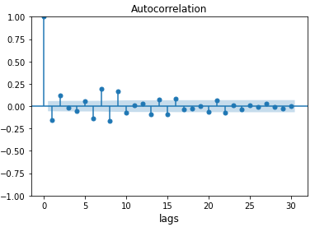
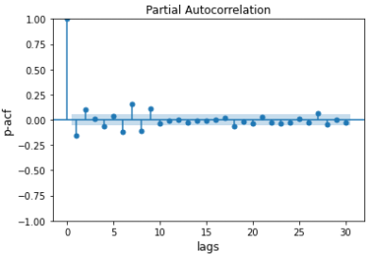
Modeling – Stock Price Prediction
Parameters
The p and q should be less than 10.
AR
MA
Notes:
SSE: Sum of squared errors can be influenced by the number of inputs. So we choose MSE

Slide 30

Bibliographical References
[1]

Slide 31
Data Preparation – for News Dataset
Since the news headlines dataset will be used for topic analysis, we need to apply basic steps about data cleaning and several text preprocessing steps in NLP on it.
Removing missing values
Removing punctuations like . , ! $( ) * % @ and unidentified special characters
Removing Stop Words
Lower casing
Tokenization
Lemmatization
Stemming

Slide 32
Data Preparation – for DJIA Dataset
Since the DJIA dataset will be used for time series analysis, we need to apply data cleaning and data transformation.
Data Cleaning
Removing missing values
Since the data we are dealing with are stock price and they are moving every day, so we decided not to remove outliers. Otherwise, we may lose important information about stock prices trending analysis.

Slide 33
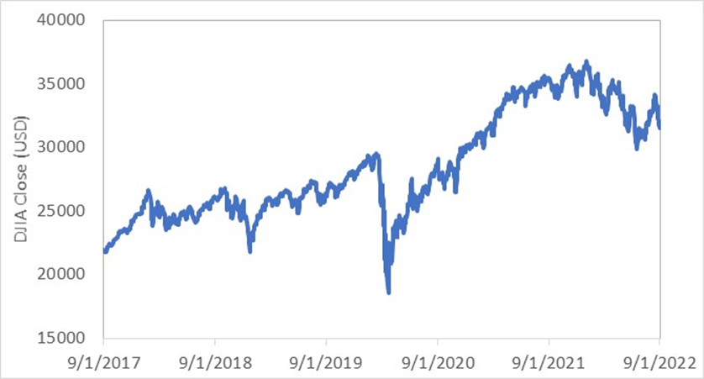
Data Preparation – for DJIA Dataset
Since the DJIA dataset will be used for time series analysis, we need to apply data cleaning and data transformation.
Data Transformation
Making non-stationary time series stationary; Differencing

Slide 34
Modeling Plan
Topic Modeling
We will perform KMeans model to get major topics in the News data set.
Stock Price prediction
We are going to use ARIMAX model, which can consider explanatory variables in addition to ARIMA model.
Candidates of explanatory variables: Number of news of each topic
Number of Comments of each topic
Number of Score of each topic
AR
MA
X

Slide 35
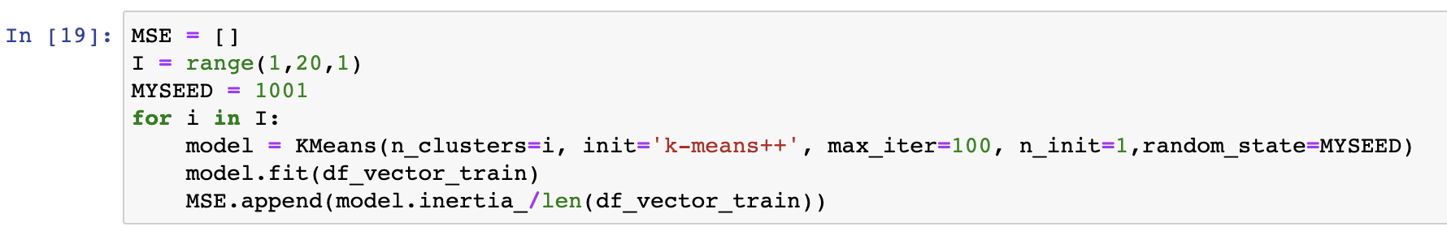
Modeling – News Data
We choose to use KMeans model to perform the topic modeling based on News Data. We use the data of latest 3 months to be the testing set and the remains to be the training dataset. The unknown data then can be predicted by applying testing dataset on the model.
The MSE (Mean Squared Errors) value is used to evaluate the model performance. (SSE vs MSE)
To make the results become more interpretative, we use range (1, 20, 1) to be the number of clusters in KMeans model.
Notes:
SSE: Sum of squared errors can be influenced by the number of inputs. So we choose MSE

